Slide 1
Project Title : Chocolate Sales Analysis Project
Name : Mahboob Khan
Date:15-05-2026

Slide 2
Agenda
Problem Statement
Business Objectives
Dataset Overview
Data Audit & Cleaning
KRA & KPI Framework
Descriptive Analysis
Diagnostic Analysis
Predictive Analysis
Dashboard Insights
Recommendations
Executive Summary

Slide 3
Problem Statement
The Chocolate Sales Analysis project aims to evaluate overall sales performance, customer purchasing behaviour, and product profitability using transactional retail data. The analysis focuses on identifying key business trends across different stores, customer segments, and product categories to support strategic decision-making. By leveraging Business Intelligence dashboards, descriptive analytics, and predictive forecasting techniques, the project provides actionable insights that help improve profitability, customer engagement, operational efficiency, and future business growth.
Track sales performance
Understand customer buying trends
Identify top-performing stores/products
Forecast future profit and revenue

Slide 4
Business Objective
The main objective of this project is to improve business performance by analysing sales, profit, customer engagement, and product demand. The project also aims to develop interactive dashboards and forecasting models to support data-driven decision-making and future business growth.
Track sales and profitability trends.
Understand customer behaviour and loyalty patterns.
Evaluate impact of discounts on profit margins.
Forecast future sales and revenue.
Build executive dashboards for decision support.

Slide 5
Dataset Overview
The dataset consists of multiple interconnected tables, including Sales, Products, Customers, Stores, and Calendar data. These tables provide detailed information about transactions, product categories, customer demographics, store operations, and time-based sales trends for comprehensive business analysis.
Total Table 5
Total Column 33
Total Rows 1006031
Table | Rows | Columns | Purpose
Sales | 1,000,000 | 11 | Transaction-level sales data
Products | 200 | 6 | Product information
Customers | 5,000 | 5 | Customer demographics
Stores | 100 | 5 | Store details
Calendar | 731 | 6 | Date intelligence

Slide 6
Data Structure – Sales Table
The Sales table is the primary fact table containing detailed transaction-level data for all chocolate sales. It includes information such as order details, product purchases, quantity sold, revenue, cost, discount, and profit, which are used for overall business performance analysis.
Column Name | Data Type | Description
order_id | Varchar | Unique order identifier
order_date | Date | Date of purchase
product_id | Varchar | Product identifier
store_id | Varchar | Store identifier
customer_id | Varchar | Customer identifier
quantity | Int | Number of items sold
unit_price | Float | Price per unit
discount | Float | Discount applied
revenue | Float | Revenue after discount
cost | Float | Estimated product cost
profit | Float | Profit from transaction

Slide 7
Data Structure – Products Table
The Products table contains detailed information about chocolate products, including product name, category, brand, cocoa percentage, and weight. This table helps analyse product performance, category-wise sales trends, and profitability.
Column Name | Date Type | Description
product_id | Varchar | Unique identifier for each product in the dataset.
product_name | Varchar | Name of the chocolate product sold.
brand | Varchar | The brand or manufacturer associated with the product.
category | Varchar | Classification of the product (e.g., dark chocolate, milk chocolate, premium).
cocoa_percent | Int | Percentage of cocoa content in the chocolate, useful for quality and taste analysis.
weight_g | Int | Net weight of the product in grams.

Slide 8
Data Structure – Customers Table
The Customers table stores customer demographic and loyalty-related information such as age, gender, loyalty membership, and registration date. It is used to analyse customer behaviour, segmentation, and purchasing patterns.
Column Name | Data Type | Description
customer_id | Varchar | Unique identifier for each customer in the dataset.
age | Int | Age of the customer, useful for demographic analysis.
gender | Varchar | Gender of the customer (e.g., Male, Female, Other).
loyalty_member | Varchar | Indicates whether the customer is part of a loyalty program.
join_date | Date | The date when the customer joined the loyalty program or registered with the store.

Slide 9
Data Structure – Stores Table
The Stores table contains information about store locations and store types, including city, country, and operational category. This table supports analysis of store performance, regional sales trends, and profitability comparisons.
Column Name | Date Type | Description
store_id | Varchar | Unique identifier for each store in the dataset.
store_name | Varchar | The name of the store where transactions occur.
city | Varchar | The city in which the store is located.
country | Varchar | The country where the store operates.
store_type | Varchar | Classification of the store (e.g., supermarket, boutique, online).

Slide 10
Data Structure – Calendar Table
The Calendar table provides date-related attributes such as year, month, week, and day information. It enables time-based analysis, seasonal trend identification, monthly comparisons, and forecasting activities.
Column Name | Data Type | Description
date | Date | The unique calendar date, serving as the primary key for linking with sales transactions.
year | Int | The year component of the date, useful for annual comparisons and aggregations.
month | Int | The month number or name, enabling monthly trend analysis.
day | Int | The day of the month, supporting daily-level reporting.
week | Int | The week number, useful for weekly summaries and comparisons.
day_of_week | int | Indicates the weekday (e.g., Monday, Tuesday), enabling analysis of sales patterns by day.

Slide 11
Data Audit & Quality Check
Data audit and cleaning were performed to ensure the quality, consistency, and reliability of the dataset. The process included checking for missing values, duplicate records, incorrect data types, referential integrity issues, and validating business rules before conducting analysis and dashboard development.
Audit Check | Result | Status
Missing Values | 0 | PASS
Duplicate Records | Removed | PASS
Referential Integrity | Validated | PASS
Negative Profit Rows | Reviewed | PASS
Date Validation | Validated | PASS

Slide 12
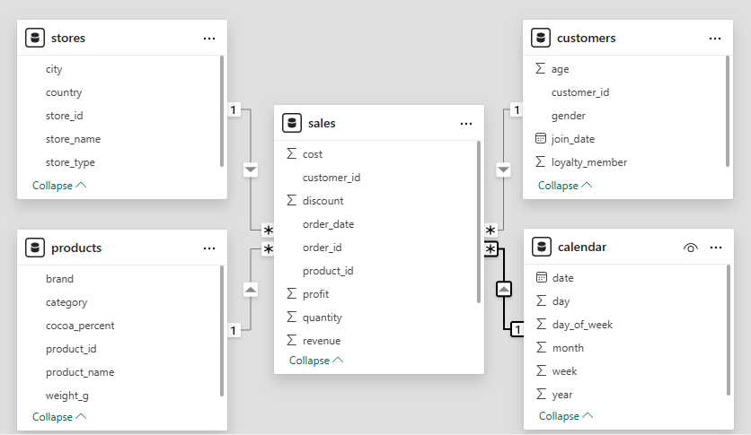
ER Diagram
The ER (Entity Relationship) Diagram represents the logical structure and relationships between different tables in the Chocolate Sales dataset. The Sales table acts as the central fact table and is connected to dimension tables including Products, Customers, Stores, and Calendar through unique identifiers such as product_id, customer_id, store_id, and date.
This relational model helps maintain data consistency, supports efficient querying, and enables comprehensive analysis across sales, customer behavior, product performance, store operations, and time-based trends. The ER Diagram also ensures proper data integration for reporting, dashboard development, and business intelligence analysis in Power BI.

Slide 13
KRA & KPI Framework
The KRA (Key Result Areas) and KPI (Key Performance Indicators) framework was designed to measure overall business performance. KPIs such as Total Revenue, Profit Margin, Average Order Value, and Customer Retention help evaluate sales growth, operational efficiency, and customer engagement.
KRA | KPI | Business Purpose
Sales Performance | Total Revenue | Measure business growth
Profitability | Profit Margin | Track operational efficiency
Customer Engagement | Loyalty Sales % | Measure retention
Product Performance | Top Products | Identify best sellers
Store Efficiency | Revenue per Store | Compare locations

Slide 14
Technology Stack to be Used
Snowflake : Cloud based Data Storage, perform Data Audit/ Cleaning tasks and to do EDA.
Power bi : Creating Dashboards as per layout and define calculated measures for all KPIs.
Databricks : Data engineering, preprocessing, and machine learning workflows
Excel/ppt : For creating presentations and explaining insights and recommendations.
Python : For descriptive, diagnostic and predictive analysis.

Slide 15
KRA & KPI Framework
The KRA (Key Result Areas) and KPI (Key Performance Indicators) framework was designed to measure overall business performance. KPIs such as Total Revenue, Profit Margin, Average Order Value, and Customer Retention help evaluate sales growth, operational efficiency, and customer engagement.
KRA | KPI | Business Purpose
Sales Performance | Total Revenue | Measure business growth
Profitability | Profit Margin | Track operational efficiency
Customer Engagement | Loyalty Sales % | Measure retention
Product Performance | Top Products | Identify best sellers
Store Efficiency | Revenue per Store | Compare locations

Slide 16
Descriptive Analysis – Key Insights
Descriptive analysis was conducted to summarize historical business performance using key metrics and visualizations. The analysis highlights overall revenue, profit, sales distribution, customer behaviour, and top-performing products and stores.
Total Revenue: 25.49M
Total Profit: 10.19M
Profit Margin maintained around 40%.
Praline category revenue : Recorded the highest revenue of 6.66 M.
Dark Chocolate 50% has the highest revenue of 1.77 M.
Praline category profit : Achieved the highest profit of 2.66 M.
Dark Chocolate 50% has the highest profit of 0.70 M.
Revenue by Gender :
Male : 12.85 M
Female : 12.63 M
Monthly revenue trends :
Highest revenue in Jan 2023
Lowest revenue in Feb 2023.

Slide 17
Diagnostic Analysis
Diagnostic analysis was performed to identify the root causes behind business performance trends. This analysis helps understand why certain products, stores, or customer segments perform better by examining profitability, discounts, customer loyalty, and seasonal sales patterns.

Slide 18
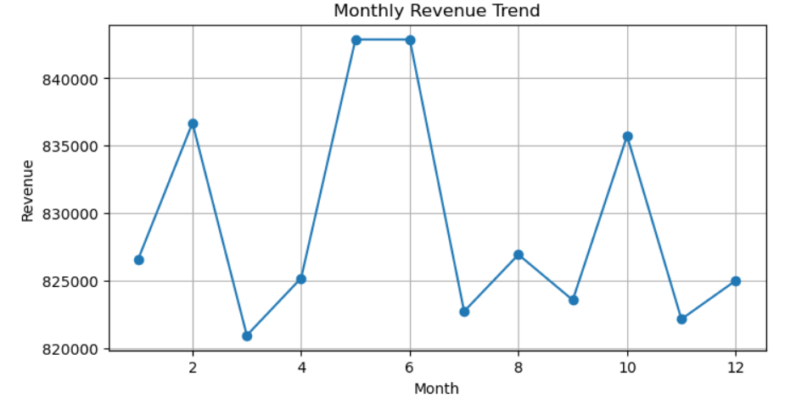
Predictive Analysis
Predictive analysis uses historical sales data and forecasting techniques to estimate future business performance. This section helps predict future revenue trends, seasonal demand patterns, and potential business opportunities for proactive planning and decision-making.
Time-series forecasting was applied using historical sales trends.
Revenue expected to grow in upcoming quarters.
Seasonal peaks predicted during festive periods.
Forecasting supports inventory and supply planning.

Slide 19
Dashboard 1 – Key Insights
This dashboard provides a high-level overview of overall chocolate sales performance across different months, product categories, store types, and countries. It helps management monitor key business KPIs such as Total Revenue, Total Profit, Profit Margin, and Total Orders while identifying top-performing categories and profitable store segments.
Key Insights:
Total revenue exceeded 25.49M, generating a total profit of 10.19M.
Airport stores delivered the highest profitability among all store types.
Praline and White Chocolate categories generated the highest revenue contribution.
Canada and the UK showed stronger profitability compared to other countries.
Monthly revenue trends remained stable with slight seasonal fluctuations.

Slide 20
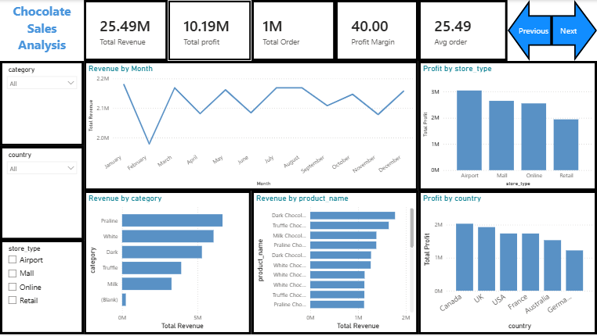
Dashboard 1 – Key Insights

Slide 21
Dashboard 2 – Key Insights
This dashboard focuses on customer behaviour, product performance, and brand-level analysis. It provides insights into loyalty membership contribution, customer demographics, age-group purchasing behaviour, and product profitability to support customer segmentation and targeted marketing strategies.
Key Insights
Loyalty and non-loyalty customers contributed almost equally to overall revenue.
Male and female customer purchasing behavior remained balanced.
Customers aged 56+ generated the highest revenue contribution.
Ferrero and Cadbury emerged as the leading revenue-generating brands.
Dark Chocolate 50% delivered the highest revenue and profit among all products.

Slide 22
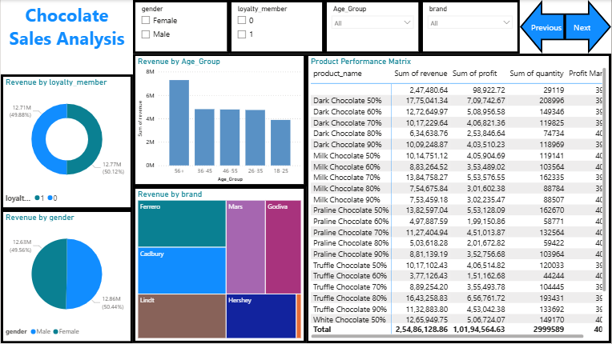
Dashboard 2 – Key Insights

Slide 23
Dashboard 3 – Key Insights
This dashboard provides detailed operational and profitability analysis by evaluating monthly profit trends, discount impact, store-level revenue performance, and top-performing products. It helps identify operational strengths, profitability drivers, and areas requiring performance improvement.
Key Insights
Profit trends remained stable throughout the year with peak performance during mid-year months.
Higher discounts negatively impacted overall profitability.
Certain stores consistently generated higher revenue compared to others.
Premium chocolate products contributed significantly to total revenue.
Operational performance varied across store locations, indicating opportunities for targeted improvement.

Slide 24
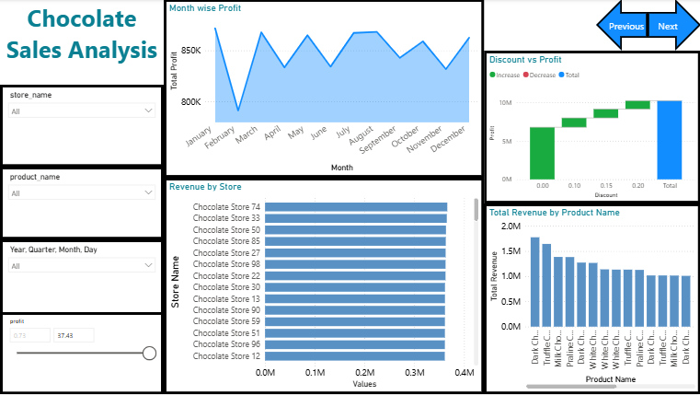
Dashboard 3 – Key Insights

Slide 25
Strategic Recommendations
Increase Focus on Premium Chocolate Categories
The dashboard analysis shows that Praline Chocolate and Dark Chocolate variants generated the highest revenue contribution, while Dark Chocolate 50% delivered the highest overall profit. The business should increase promotional campaigns, shelf visibility, and premium packaging for these products to maximize profitability.
2. Strengthen Airport Store Operations
Among all store types, Airport stores generated the highest profit (3.05M), outperforming Mall, Online, and Retail stores. This indicates stronger customer spending behaviour in airport locations. The company should prioritize premium inventory, combo offers, and exclusive products in airport stores to further increase profit margins.
3. Optimize Discount Strategy to Protect Profit Margins
The profitability analysis indicates that average profit decreases as discount percentages increase. Orders without discounts generated the highest profit, while 20% discount levels significantly reduced margins. The company should avoid excessive discounting and implement targeted promotional campaigns instead of blanket discounts.

Slide 26
4. Improve Performance of Retail Stores
Retail stores generated the lowest overall profit compared to other store types. This suggests operational inefficiencies or weaker customer demand in retail locations. The business should improve local marketing campaigns, optimize inventory planning, and introduce customer engagement activities to improve retail store performance.
5. Focus on High-Performing Brands
Dashboard insights show that brands such as Ferrero, Cadbury, and Lindt generated stronger revenue contribution compared to other brands. Increasing marketing investment and product availability for these brands can improve overall sales performance and customer satisfaction.
6. Target Older Customer Segments
Customer analytics reveal that the 56+ age group contributed the highest revenue among all customer segments. The company should develop targeted marketing strategies, premium gift packaging, and loyalty offers specifically designed for mature customers to increase repeat purchases.

Slide 27
7. Expand Loyalty Membership Programs
Revenue contribution from loyalty members was nearly equal to non-loyalty customers, indicating strong engagement potential. Introducing personalized rewards, cashback offers, and member-exclusive promotions can improve customer retention and long-term profitability.
8. Use Monthly Profit Trends for Inventory Planning
The monthly profit trend analysis shows seasonal fluctuations across different months. The business should use historical sales trends to forecast demand, optimize stock availability, and prepare inventory before peak sales periods to avoid stock shortages and missed revenue opportunities.
9. Focus on High-Revenue Countries
Country-wise profitability analysis shows that Canada and the UK generated stronger profit contribution compared to other regions. Expanding marketing activities, premium product distribution, and promotional campaigns in these countries can support future business growth.

Slide 28
Executive Summary
The Chocolate Sales Analysis project was conducted to evaluate overall business performance, customer purchasing behaviour, product profitability, and operational efficiency using SQL, Python, and Power BI. The analysis was performed on transactional sales data to identify key business trends, revenue drivers, and opportunities for business improvement.
The business generated a total revenue of 25.49M with an overall profit of 10.19M, maintaining an average profit margin of approximately 40%. Analysis revealed that Airport stores delivered the highest profitability, while Praline Chocolate and Dark Chocolate variants emerged as the top-performing product categories in terms of both revenue and profit contribution.
Customer analysis showed balanced purchasing behaviour across gender segments, while the 56+ age group contributed the highest revenue among all customer categories. Brand-level analysis identified Ferrero, Cadbury, and Lindt as major revenue-generating brands. Additionally, loyalty members contributed significantly to total sales, highlighting strong customer retention potential.

Slide 29
THANK YOU!

